Slide 1
NE 591: Advanced Reactor Materials
Fall 2021
Dr. Benjamin Beeler

Slide 2
Last Time
Graphite has a lot of texture and porosity, dependent upon fabrication
Graphite shrinks, then undergoes turnaround
This behavior is governed by point defects and Mrozowski cracks
Turnaround happens quicker at higher temperatures, and is dependent upon applied stress
Irradiation creep is critically important in graphite

Slide 3
TRISO Fuel Failures

Slide 4
Fuel Failure Mechanisms
Overpressure
During irradiation, fission gases are released from the kernel into the porous buffer layer. The pressure that is generated exerts tensile forces on the SiC layer of the particle
For UO2 kernels, there is also excess oxygen released during fission which will react with carbon from the buffer to form CO and CO2 gas
Particles are generally sized with a large enough buffer void volume to ensure that they do not fail by overpressure during irradiation
Particle failure is postulated to occur as a result of an insufficient or missing buffer layer that occurs during the coating process

Slide 5
Fuel Failure Mechanisms
Irradiation-induced IPyC cracking
Under irradiation, pyrocarbon (PyC) shrinks in both the radial and tangential directions
At modest fluences it begins to swell in the radial direction
This behavior puts the PyC layers into tension in the tangential direction
However, irradiation-induced creep works to relieve the tensile stress in the PyC layer
If the PyC is strongly attached to the SiC layer, the PyC shrinkage provides a strong compressive stress that offsets the tensile stresses generated by gas production in the kernel

Slide 6
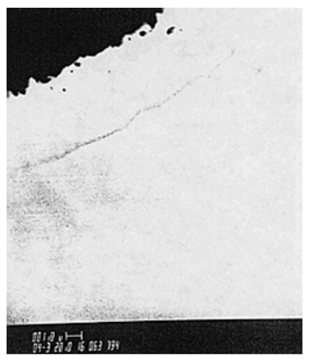
Fuel Failure Mechanisms
Debonding between IPyC and SiC
The debonding is related to the strength of the IPyC/SiC interface
Weakly bonded coating layers can partially detach because of the tensile stresses generated by the IPyC shrinkage under irradiation
A particle for which partial debonding of the IPyC from the SiC has occurred can develop relatively large tensile stresses in the SiC
Irradiation induced creep relieves the stress at longer times

Slide 7
Fuel Failure Mechanisms
Kernel migration
Kernel migration is defined simply as movement of the kernel toward the TRISO-coating, which can lead to the kernel penetrating the TRISO-coating
Kernel migration is associated with carbon transport in the particle in the presence of a temperature gradient
A thermal gradient generates different equilibrium conditions for C, UO2, CO and CO2 at either side of the particle
Carbon diffuses up the temperature gradient, the kernel diffuses down

Slide 8
Fuel Failure Mechanisms
Fission product attack
Fission products can be transported from the kernel to the inner surface of the SiC where they interact and can damage and potentially fail the SiC layer
This is more of an issue in UC kernels
In UCO kernels, the oxycarbide form of the kernel generally ties up all but the noble fission products (e.g., Pd) as either carbides or oxides, which tend to limit their mobility in the UCO system
However, Pd and Ag transport have still been observed in UCO coated particle fuel

Slide 9
Fuel Failure Mechanisms
Matrix-OPyC interactions and OPyC irradiation-induced cracking
During manufacture, infiltration of the liquid graphitic matrix into the porosity of OPyC caused mechanical weakening
During subsequent dimensional change under irradiation this caused OPyC layer to fail by cracking and debonding from the SiC layer
This has largely been addressed through specifications on the matrix material and on the microstructure of the OPyC
Non-retentive SiC
There are situations where the SiC layer becomes functionally failed or degraded in some way and is no longer retentive of fission products
Diffusive release through intact layers
If fuel temperatures during normal operation approach 1300C, then some of the fission products that are usually retained by the TRISO coating (e.g., cesium) will be able to diffuse out of the particle during normal operation
SiC degradation resulting in permeability
Cesium attack of the SiC and/or CO corrosion of the SiC can allow fission products to be released at high burnup

Slide 10
Fuel Failure Mechanisms
Creep failure of PyC
Under stress, thermal creep of the PyC will occur
In some post-irradiation heating tests, photomicrographs reveal a thinning and failure of the PyC
Such failure has not led to failure of the SiC layer
SiC thermal decomposition
At very high temperatures (> 2000C) the SiC layer undergoes thermal decomposition
The phenomenon is primarily a function of temperature and time and has not played a major role in fuel failure at lower accident temperatures

Slide 11
Fuel Failure Mechanisms
Kernel-coating mechanical interaction (KCMI)
At sufficiently high burn-up values, it is inevitable that all gas gaps between the kernel and coatings will close, thereby resulting in a mechanical interaction between the two
Modelling studies predict that the SiC layer will fail shortly after the onset of KCMI
This failure mechanism could be of increasing importance as attempts are made to achieve higher burn-up values

Slide 12
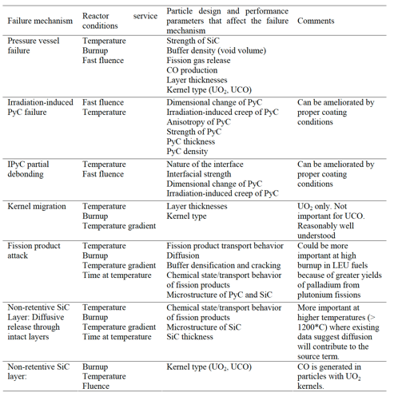
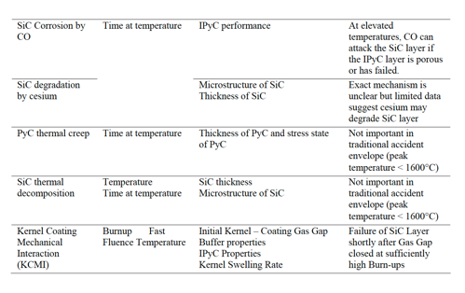
Fuel Failure Mechanisms

Slide 13
Fuel Failure Summary
Overpressure
IPyC cracking
IPyC and SiC debonding
Kernel migration
Fission product attack
Creep failure of PyC
SiC decomposition
KCMI
These failure mechanisms have been observed to some extent in TRISO-coated fuel testing activities conducted around the world
They are in general functions of temperature, burnup, fluence and temperature gradient in the particle and details of the particle design
TRISO-coated fuel is usually designed such that none of the fuel failure mechanisms are expected to be significant

Slide 14
TRISO Fuel Performance

Slide 15
TRISO Fuel Performance
Fuel performance models need to be able to account for numerous inter-related phenomena that affect temperatures, stresses, and failure of the material systems
Must be multiphysics, incorporating thermodynamics, chemistry, kinetics, microstructure, mechanics, etc.
Solid fission product swelling
Gaseous fission product swelling
Densification
Thermal conductivity
Fission gas release
CO production
Oxygen transport
PyC layer dimensional change
Kernel migration
SiC failure
Fission product attack

Slide 16
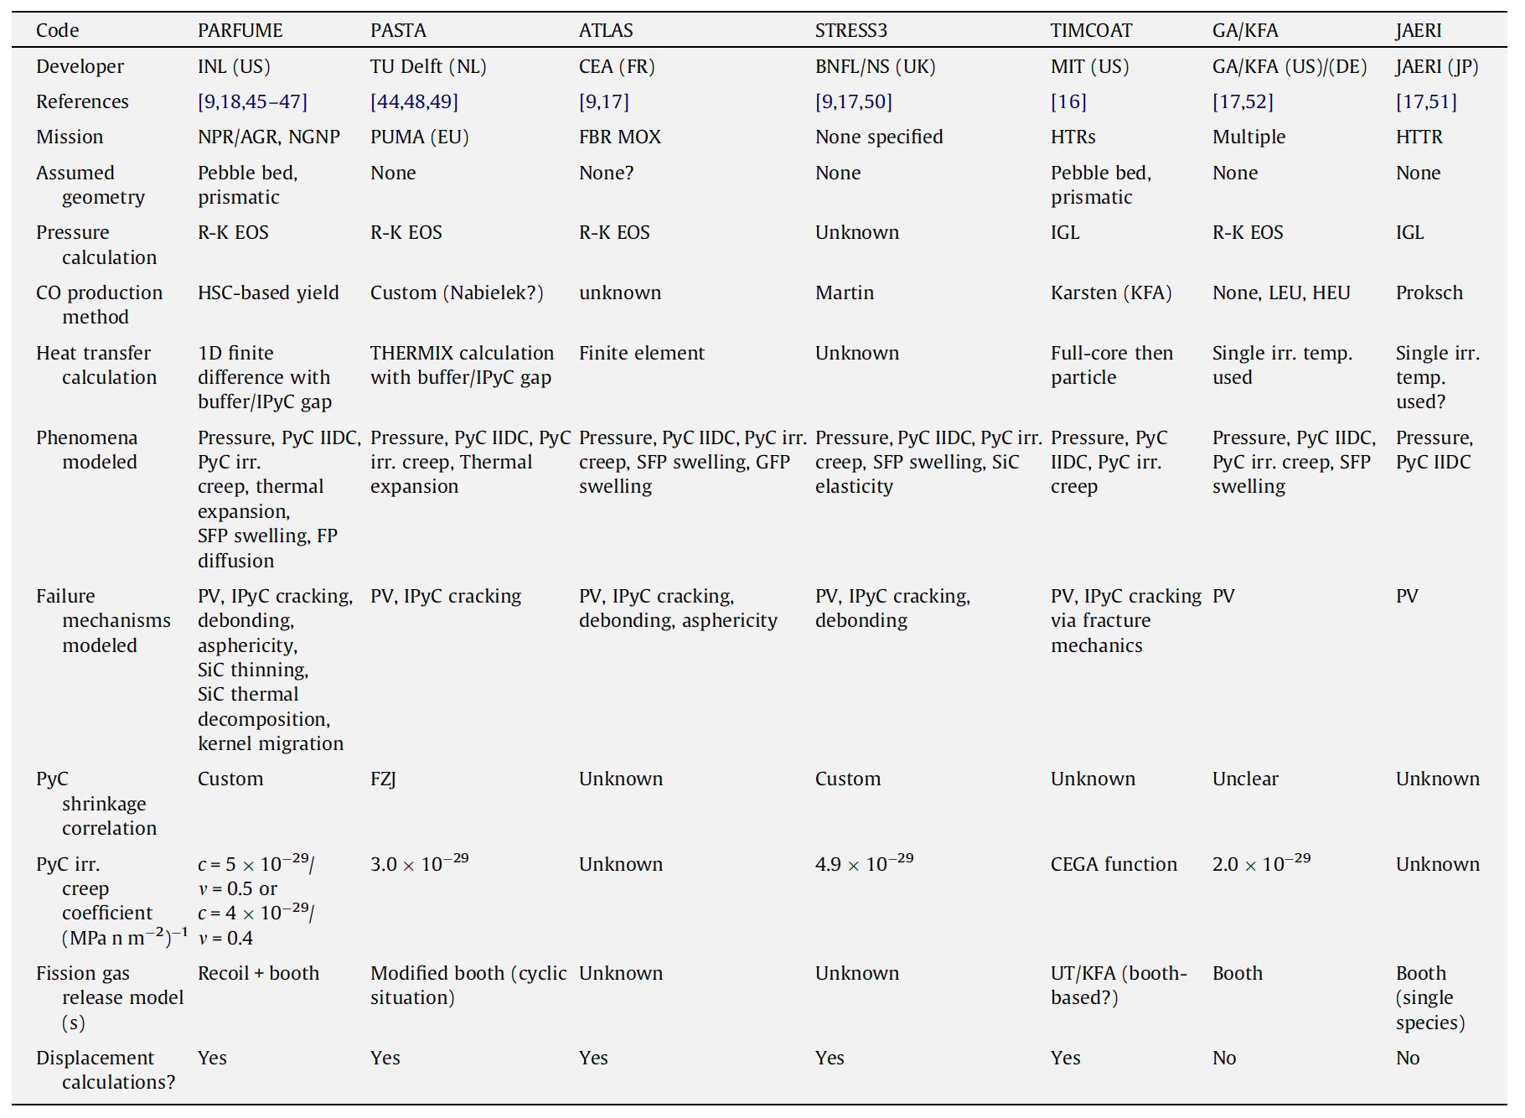
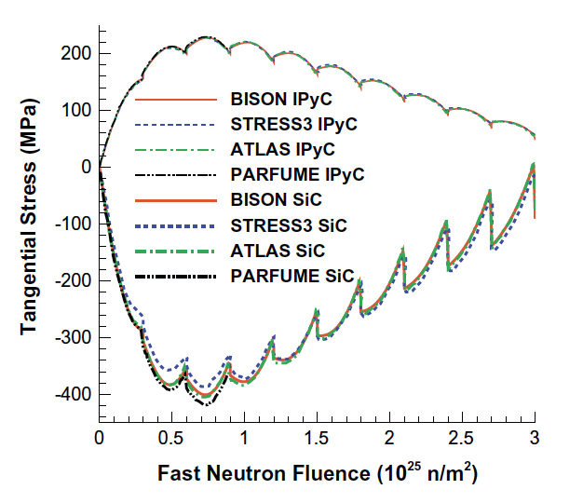
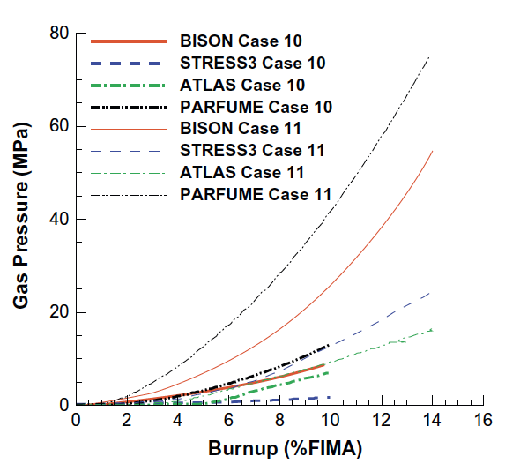
Fuel Performance Codes

Slide 17
SiC Failure
The dominant 1D failure mechanism for TRISO fuel particles involves pressure vessel failure, where the SiC layer develops a through-thickness crack resulting from a tensile stress that exceeds the fracture strength of the material
Modern approaches to pressure vessel failure explicitly calculate separate stresses and through-layer crack probabilities for the SiC layer and each PyC layer

Slide 18
TRISO Stresses
The irradiation causes the kernel to swell and the buffer layer to shrink, thereby modifying the internal void volume available to the fission and reaction gases
The porosity of the buffer results in the only force impinging on the three load bearing layers being the gas pressure on this surface
If the IPyC and OPyC were absent, the gases produced in the fission process would simply stress the SiC layer and, if the pressure were high enough, cause it to fail
However, these tangential stresses are reduced by the presence of the two PyC layers because; under unrestrained conditions they would shrink during irradiation

Slide 19
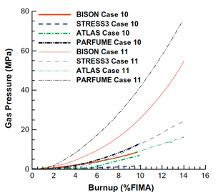
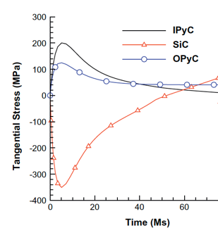
TRISO Stresses
PyC shrinkage will be largely restrained by the SiC layer, and tangential stresses will be generated in both PyC layers and radial, inward acting forces imposed on the two surfaces of the SiC layer
In practice, these tangential stresses in the two PyC layers will attain a quasi-equilibrium stress state because their shrinkage is counter-balanced by irradiation creep
The SiC elastic modulus is at least an order of magnitude greater than that of PyC and thus, the dimensional changes and creep strains of SiC are comparatively much smaller than for PyC

Slide 20
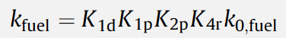
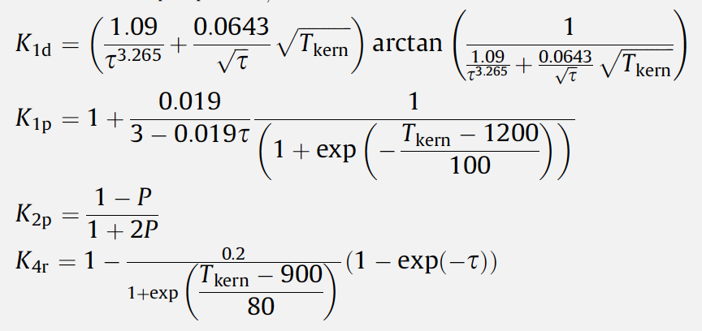
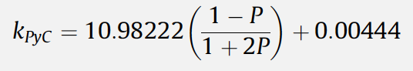
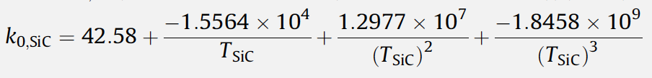
Material Evolution
Ideally, would be able to model and describe 3D modes of failure
Shrinkage cracks within the IPyC layer
IPyC/SiC debonding
Particle asphericity
Kernel migration
SiC coating thinning
Fission product attack

Slide 21
Data needs
There are a number of areas where we lack requisite data, either behavioral or fundamental properties, in order to accurately describe TRISO particle evolution
High-quality high burnup data on TRISO particles is generally lacking, which would enable benchmarking of fuel performance models
Uncertainties and unknowns in fundamental material properties are also abundant, especially with regard to how properties vary as functions of temperature, fast fluence, and burnup
There is significant uncertainty in the irradiation creep constant, the value of Poisson’s ratio in irradiation creep models, and the thermal conductivity of PyC
Predictions for the chemical attack of SiC require effective diffusion coefficients of key fission products in various fuel materials, which are unknown
Fuel properties are the least well understood, especially as the fuel evolves during operation

Slide 22
Advanced concepts in TRISO

Slide 23
ZrC replacing SiC
Zirconium carbide (ZrC) is a refractory and chemically stable compound, which melts eutectically with carbon at 3123 K
ZrC can potentially improve the high-temperature stability, the resistance to chemical attack by fission products, and the retention of fission products
However, ZrC is significantly less oxidation resistant than SiC

Slide 24
ZrC replacing SiC
Four types of ZrC inclusions have been studied (1) ZrC-TRISO coated particles, (2) ZrC-TRISO type coated particles without OPyC layer, (3) ZrC-coated particles with ZrC-doped OPyC layer, and (4) ZrC coated particles with graded C–ZrC layer(s)
All four types have been fabricated and irradiated
Primary focus has been on option 1, however usage of ZrC started from option 2 in the 1970s
ZrC-TRISO-coated UO2 particle after irradiation at 1673–1923K to 4.5% FIMA

Slide 25
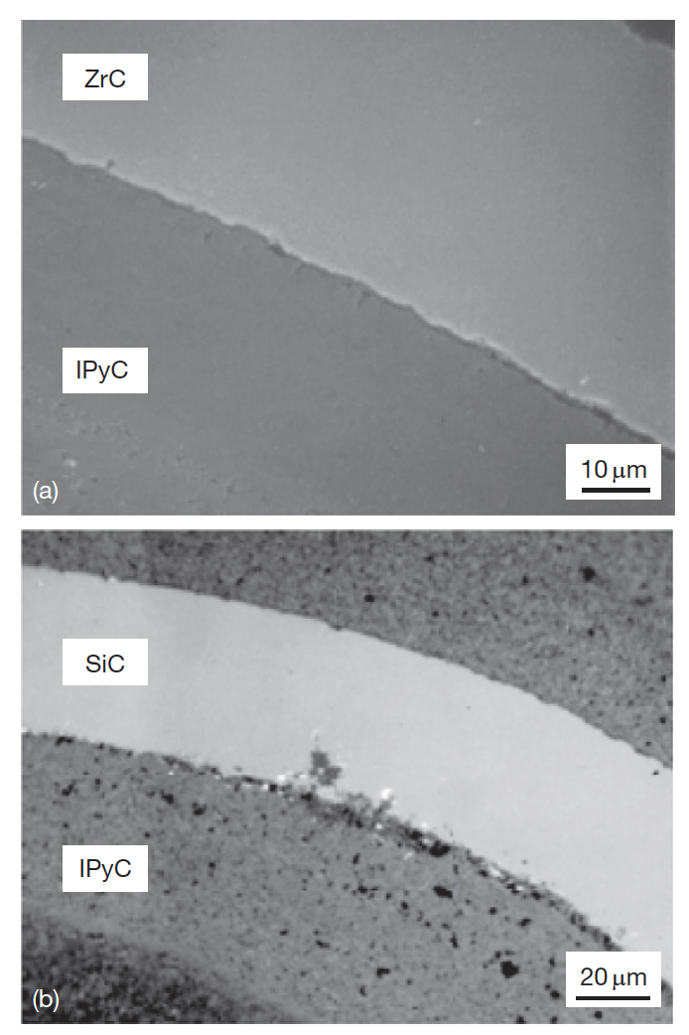
ZrC replacing SiC
The improved performance of the ZrC coating layer against chemical attack by Pd has been demonstrated in both out-of-reactor experiments and irradiation tests
ZrPd3 can form in lab conditions, but insufficient Pd exists in fuel particles to cause formation and thus degradation
ZrC does not seem to solve the silver problem
Ruthenium release might be an issue, which it is not for SiC

Slide 26
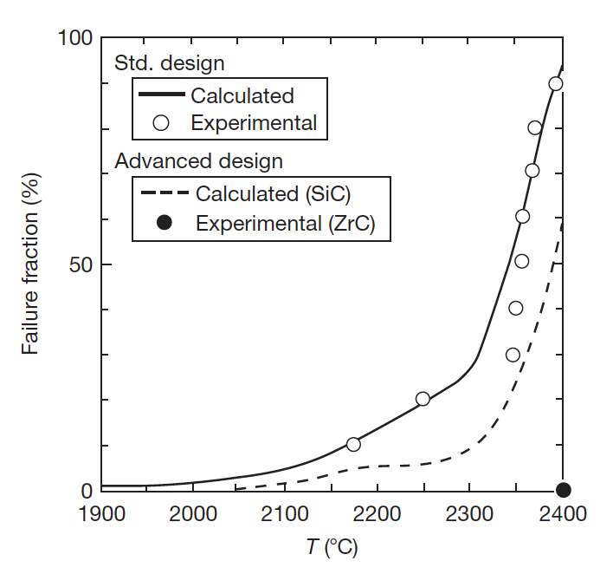
ZrC replacing SiC
High-temperature behavior of ZrC is superior to SiC
Right is a heating experiment on irradiated TRISO particles
No ZrC failures up to 2400C, where an extended hold produced a failure
Thus, better stability during fabrication, ability to operate at higher temperatures, better stability in off-normal temperature spikes, better fission gas retention at high temperature

Slide 27
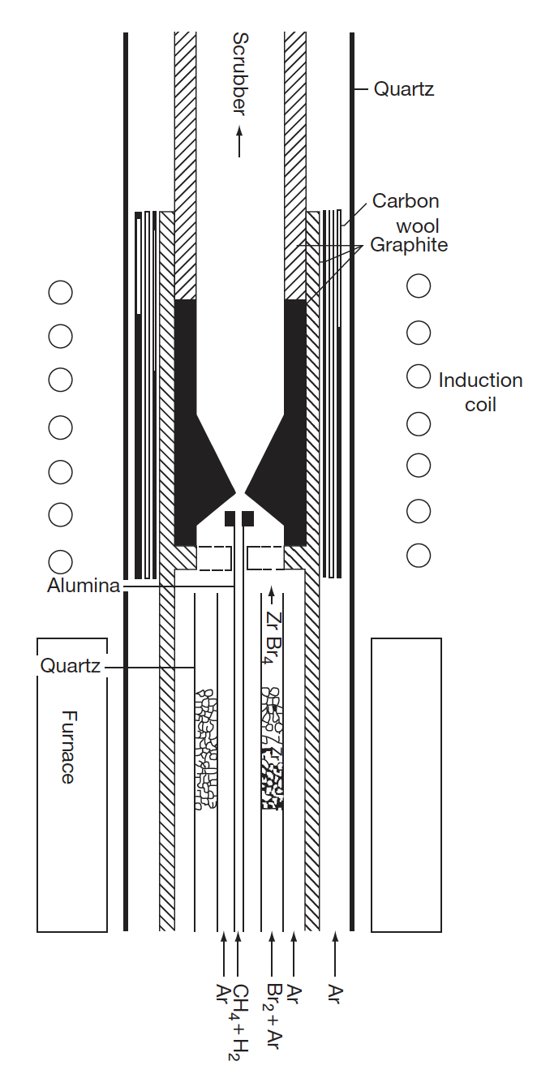
ZrC Fabrication
Fabrication of ZrC coatings has been established in a lab setting
Not yet an industrial process, thus not feasible for large scale production

Slide 28
Non-fissile Carbides in Fuel
To inhibit the buildup of CO gas in UO2 fuel kernels, UC2 is often added to getter oxygen and reduce the oxygen potential
Similar results can be achieved by the addition of nonfissionable carbides, such as SiC or ZrC around fuel kernel
Additional benefits might be gained by placing getters of this type at the outer boundary of the UO2 kernels

Slide 29
Non-fissile Carbides in Fuel
Introduction of ZrC around fuel kernel getters released oxygen
This seems to inhibit fuel kernel migration
If the layered ZrC is intact, can inhibit fuel swelling as well, potentially reduced stresses on outer layers
Have performed limited irradiation experiments with no failures
If the layered ZrC is intact, no release occurs for Ag and Eu
Release occurs for both species under same conditions for nominal TRISO and for ZrC dispersed in buffer
An intact ZrC layer seems to be necessary for explaining the outstanding retention of these particles, in addition to the benefits of O gettering

Slide 30
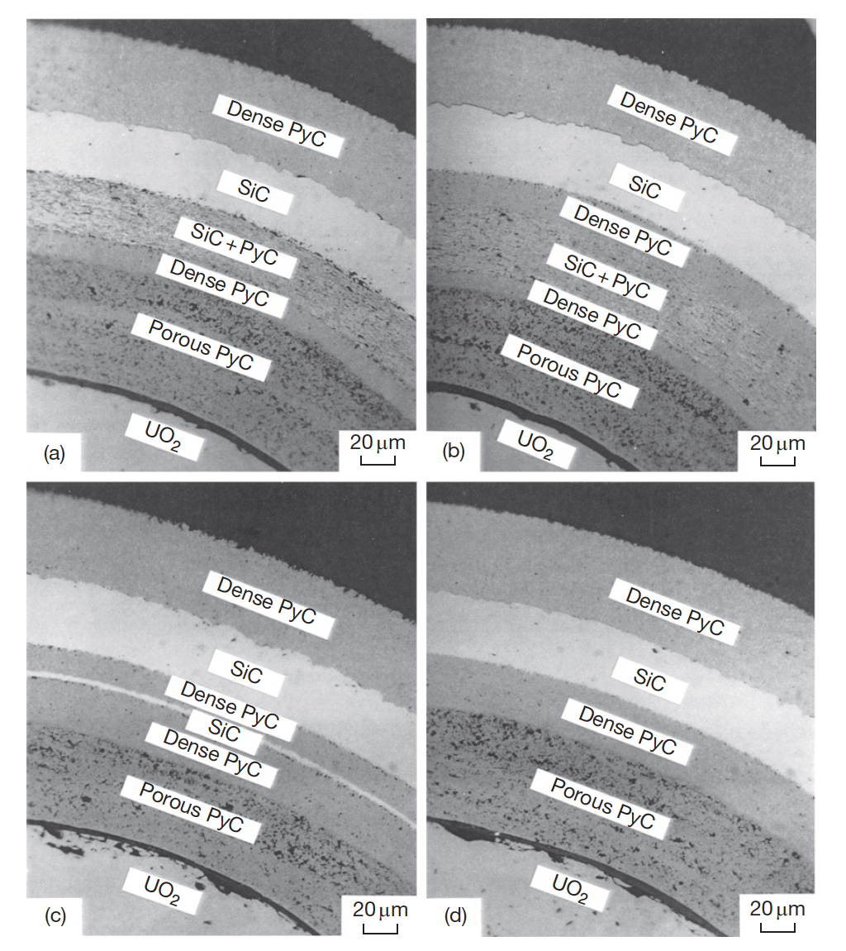
Alternate Layering
Two methods are available to prevent the corrosion of the SiC layer: (1) to keep the fission products within the fuel kernel and (2) to make a barrier to the diffusion of the fission products to the SiC layer
Can potentially add a layer that traps palladium by chemical reaction inside the SiC layer of the TRISO coating
Can add either an additional SiC layer, or a SiC/PyC composite layer

Slide 31
Alternate Layering
The type-A coating has an additional layer of SiC+PyC adjacent to the inside of the SiC layer; the thickness of the IPyC layer can be reduced
The type-B coating has the dense PyC layer between the SiC+PyC and SiC layers; the intermediate dense PyC layer will interrupt extension of the corrosion zone from the SiC+PyC layer to the SiC layer
In the type-C coating, SiC is used for an additional layer; SiC layer will react with fission products and PyC will interrupt corrosion of outer SiC

Slide 32
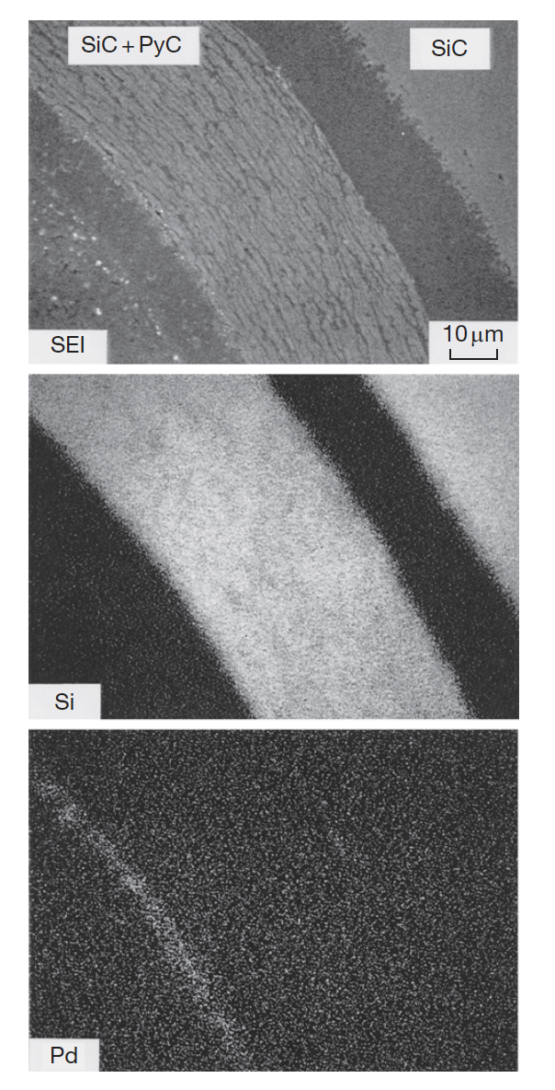
Alternate Layering
Irradiation of these advanced coatings was performed in the JRR-2 reactor
Ceramography revealed no crack in the advanced coating layers or in the TRISO coating layers
All three types trapped Pd at the inner SiC-based barrier, preventing corrosion of the outer SiC
At high heating, a PyC layer between the outer SiC and the inner SiC-based layer proved more effective at fission product retention
Also, the SiC/PyC layer proved more effective than pure SiC
No new technology needed to fabricate these particles
Type B Coating

Slide 33
Summary
Fuel Failure mechanisms
design and proper fabrication can limit most failure mechanisms
as we drive toward higher burnup, additional problems may arise
TRISO Fuel performance
there are a number of fuel performance codes
data needs, and the evolutionary complexity of particles hold back more sophisticated modelling
Advanced concepts in TRISO particles
ZrC instead of SiC
ZrC/SiC as a layer around kernel
alternate layering of SiC/PyC

Slide 34
Questions?

Slide 35
Quiz Upcoming!
Will cover TRISO particle-based fuels
Quiz will be on Sept 7th
Will keep it here unless there is a strong will to move it to the 2nd
Open ended questions covering the concepts presented in class

